Slide 1



Project review project title: Entertainer Analysis
ileen xaxa

Slide 2
Agenda
Introduction
Offer Letter
About the Company
About the Project
Data set
Software tools
Visualization
Conclusion

Slide 3

Introduction
Role: DATA ANALYST
At: Unified Mentor
Duration : 3 months (15-03-24 to 15-06-24)
3

Slide 4

Offer letter

Slide 5


Project
Normal life can be stressful, and people need to relax. Being entertained by others is a
wonderful way to take some time out of life. It can reduce stress and make life's issues
easier to face. The media and entertainment industry consists of film, television, radio
and print. These segments include movies, TV shows, radio shows, news, music,
newspapers, magazines, and books. The entertainment industry is a group of
sub-industries devoted to entertainment. The entertainment industry is used to
describe the mass media companies that control the distribution and manufacture of
mass media entertainment.
Entertainer Data Analytics
5

Slide 6

Tools
Python
Excel
Power Bi
6

Slide 7
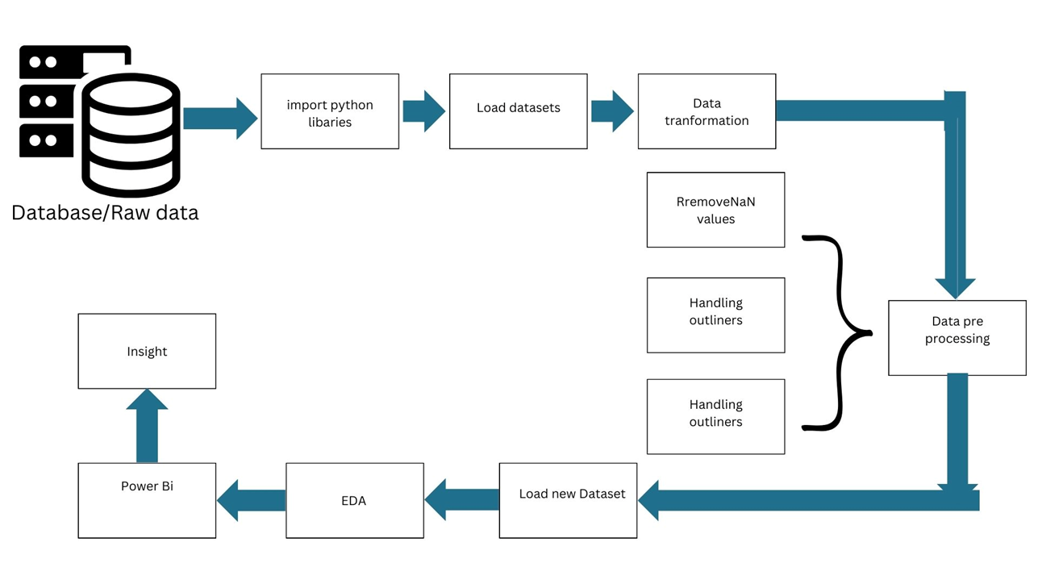
Architecture diagram

Slide 8
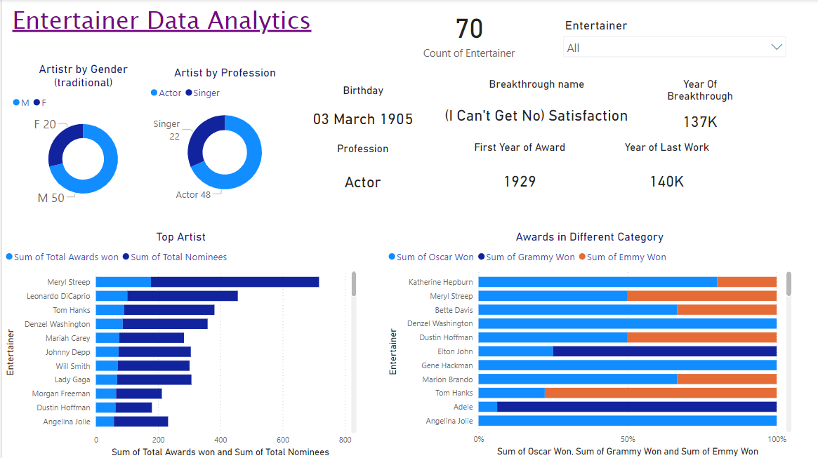
Dashboard

Slide 9
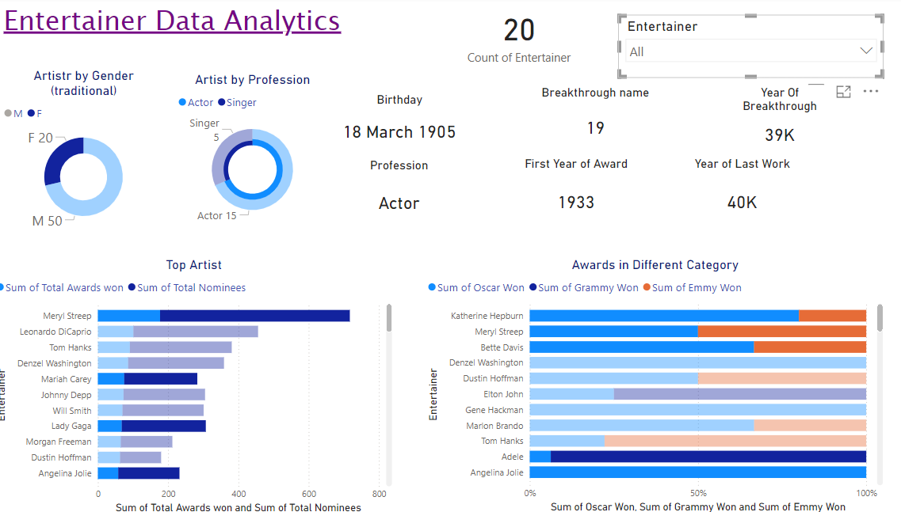
Dashboard for Female Artist

Slide 10
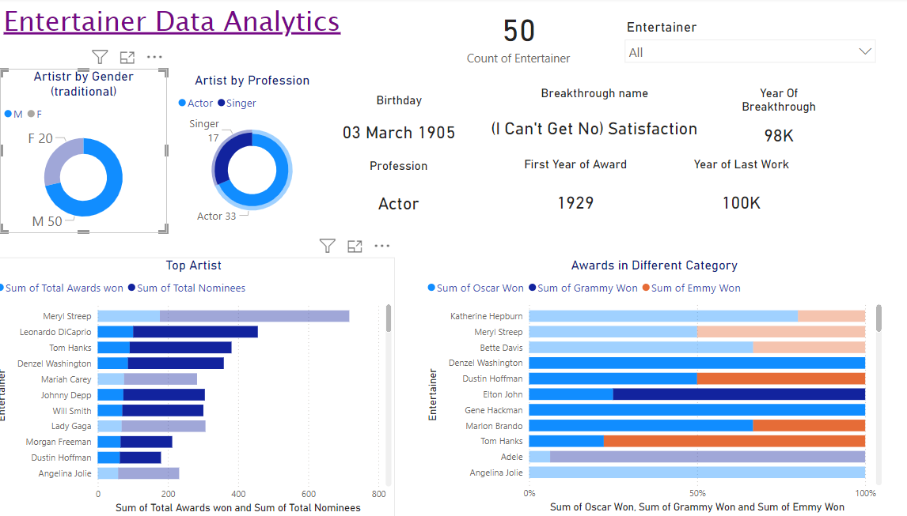
Dashboard for Male Artist

Slide 11
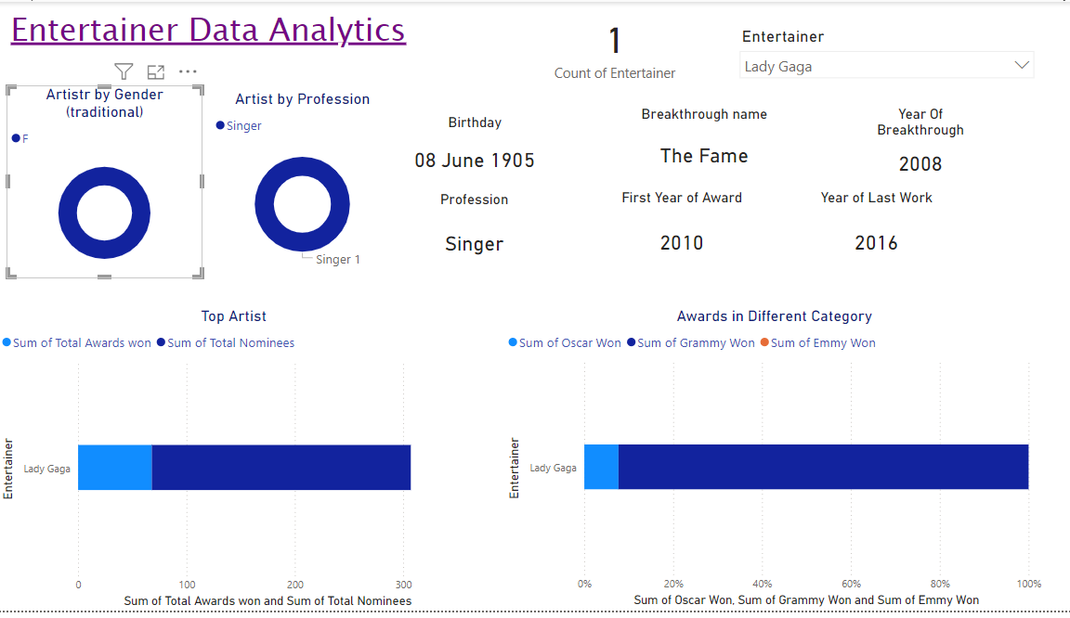
Individual Artist- singer

Slide 12
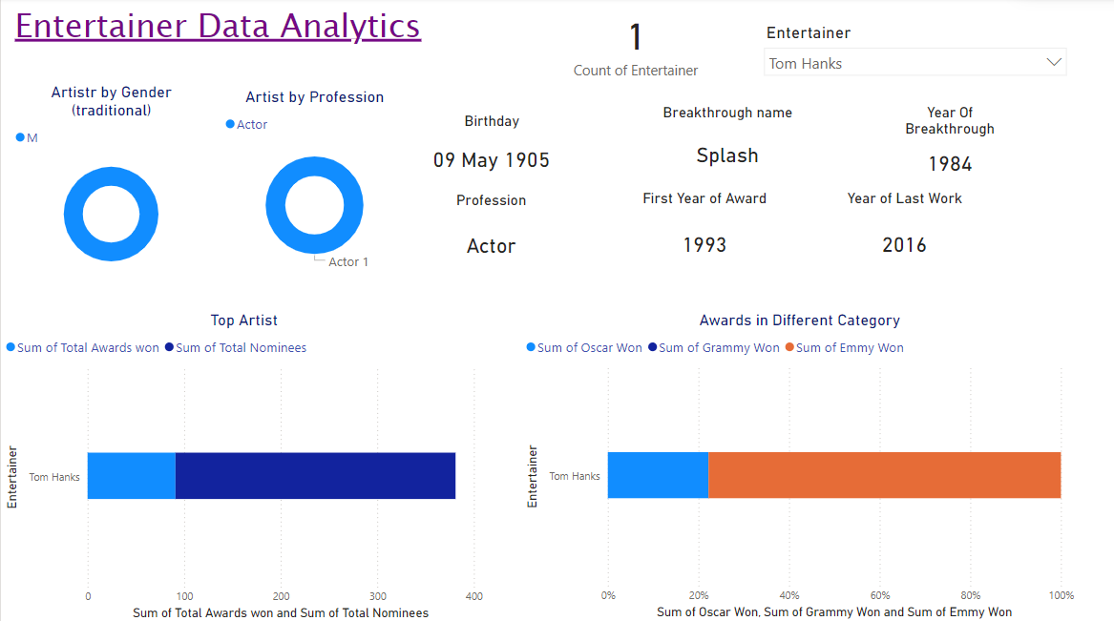
Individual Artist- actor

Slide 13
Insights
Meryl streep is the best entertainer with 177 total wins including 3 Oscars and 3 Emmys also she has 540 nominees
Most of the Entertainers are From Actors category.
Katherine Hepburn has the Highest Oscars (4).
Oprah Winfrey has the Highest Emmies (18).
Stevie Wonder has the Highest Grammies (24).
Stevie Wonder has the Highest Known awards (24 Grammies + 1 Oscar)
There are very less entertainers who won awards from their breakthrough

Slide 14




Thank you

